Slide 1


Data Structures and Algorithms
Module 1
Analysis of Algorithm

Slide 2

Analysis of Algorithms
Master’s Theorem

Slide 3
Master’s Theorem
Master’s theorem is one of the many methods that are applied to calculate time complexities of algorithms.
In analysis, time complexities are calculated to find out the best optimal logic of an algorithm.
Master’s theorem is applied on recurrence relations.

Slide 4
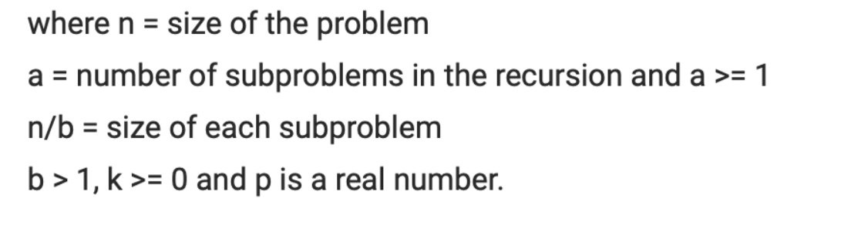
T(n) = aT(n/b) + f(n)
f(n)= Θ(n^{k} log^{p} n)
Example: T(n) = 8T(n/2) + n² log n

Slide 5
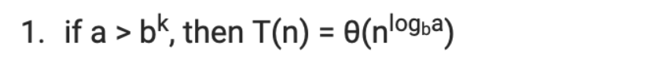
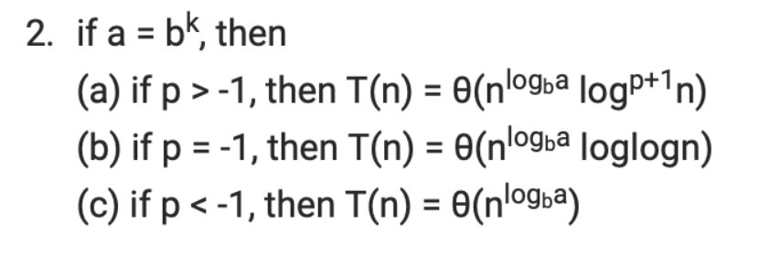
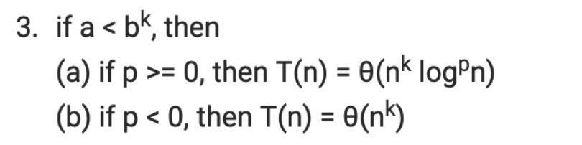
T(n) = aT(n/b) + f(n)

Slide 6
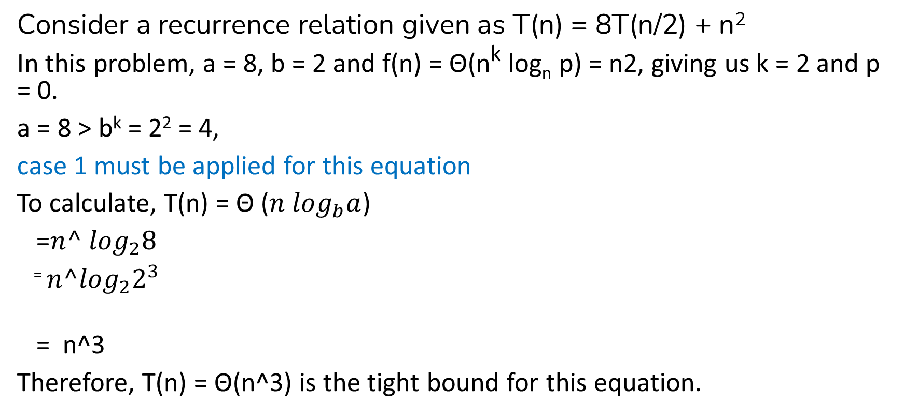
Example 1
Consider a recurrence relation given as T(n) = 8T(n/2) + n²
In this problem, a = 8, b = 2 and f(n) = Θ(n^{k} log_{n} p) = n2, giving us k = 2 and p = 0.
a = 8 > b^{k} = 2² = 4,
case 1 must be applied for this equation
To calculate, T(n) = Θ (${n log}_{b}a$)
=${n^ log}_{2}8$
⁼ ${n^log}_{2}2^{3}$
= n^3
Therefore, T(n) = Θ(n^3) is the tight bound for this equation.

Slide 7

Example 2
T(n)=16 T(n/4)+n
a=16 ; b=4 ; k=1 ; p=0
a>b^{k}
^{16>4}
^{Case 1:} $Tn= θ\left({n log}_{b}a\right)$
= $\left({n log}_{4}16\right)$
= $\left({n log}_{4}4^{2}\right)$
= n²
= (n²)

Slide 8

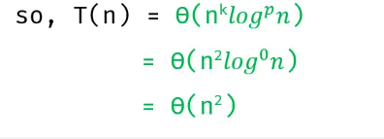
Example 3
Case 3:

Slide 9
Problems to practice

Slide 10
Master Theorem Limitations
T(n) is not monotone. eg. T(n) = sin n
f(n) is not a polynomial. eg. f(n) = 2n
a is not a constant. eg. a = 2n
a < 1
a < 1

